Slide 1
Retail Trade Sales and Food Services Sales
Group 4
Arun Kumar
Pooja Lahoti
Kseniya Davis
Hamd Mazhar
Dhaval METRE
Muthu Kannan Subramanian
Pradeep Kumar Madhangopal

Slide 2
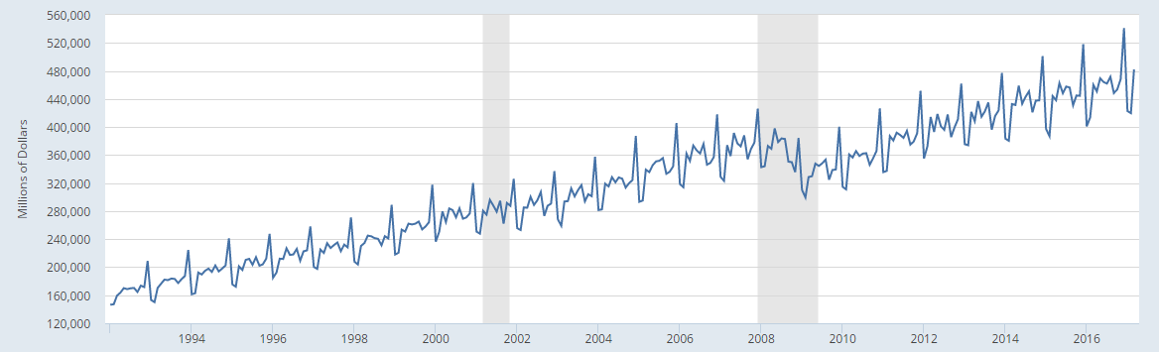
Retail Trade Sales and Food Services Sales
January 1992 to March 2017

Slide 3
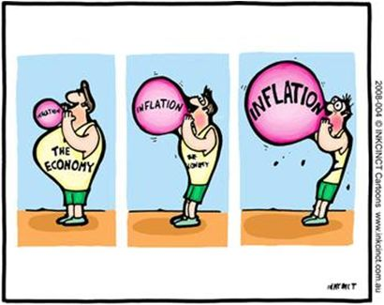
Decision Environment
Retail Trade Sales and Food Service Sales (RSAFSNA) is a component of US GDP.
The economy is approximately 2/3rds driven by the consumer, and retail sales is a good proxy for consumer spending.
The FED uses the rate of GDP growth as an indicator of economic expansion. If perceived as expanding too rapidly, the FED is likely to increase the bank borrowing rate. In turn, if the GDP growth is estimated to be moderate, interests rates will remain at current rate or even lowered.
In this decision environment, the risk is higher in overstating the sales. If FED increases the interest rates in error, it may lead to stagnation of US GDP growth.

Slide 4
Observation & Transformation
Linear upward trend.
Exhibiting strong seasonal cycle with peaks in the month of December, and the dips in the month of January & February.
Change in variations across the seasonal spikes

Slide 5
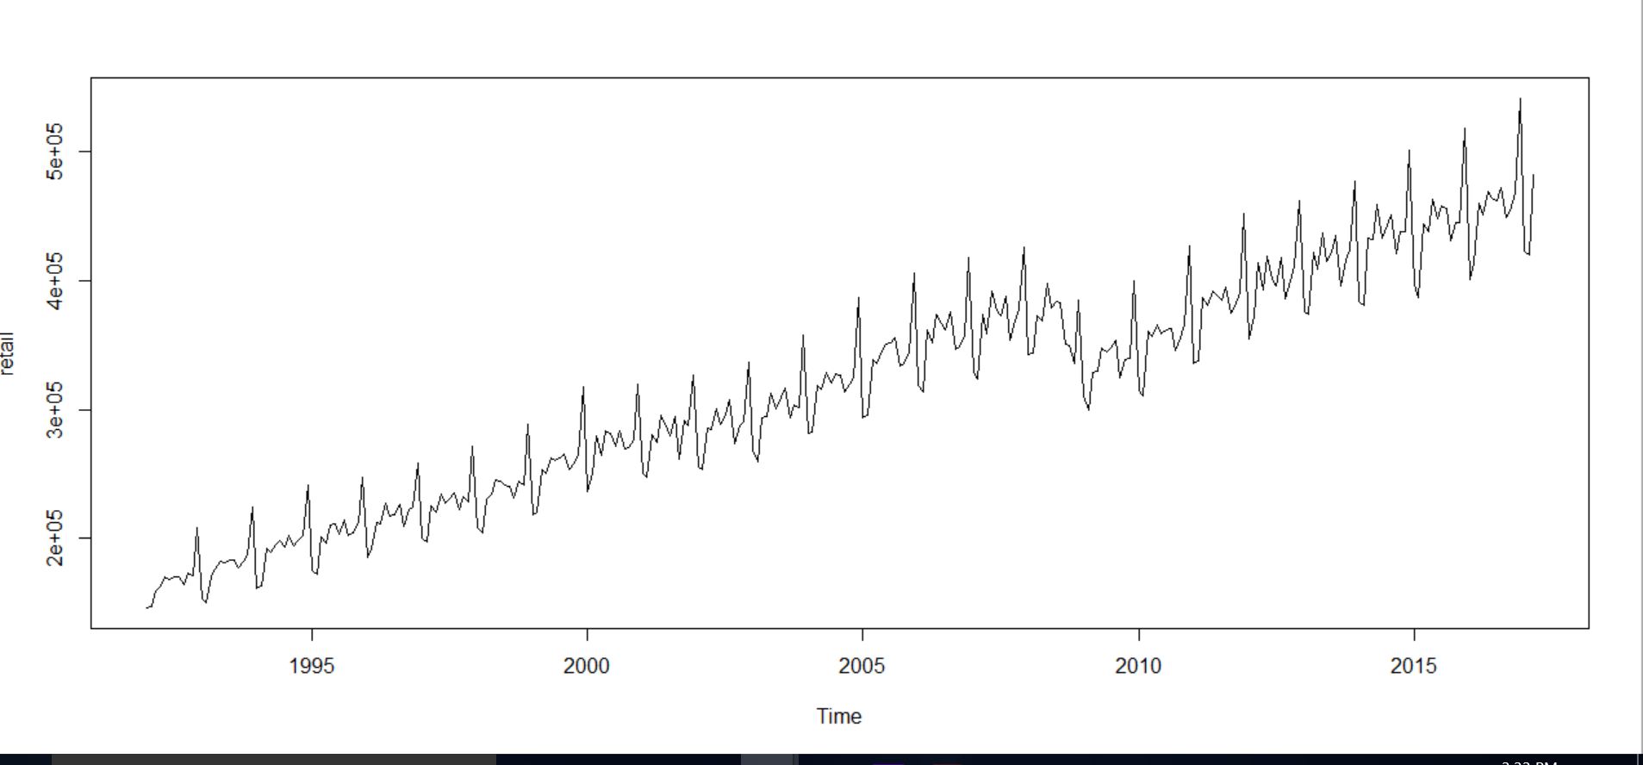
Observation & Transformation

Slide 6
Holdout Period and Deterministic variable
Holdout period:
Here, last 4 observations are excluded from the time series object defined. This is done to verify the forecasted values for the excluded observations.
Deterministic variable:
Here, ‘trend’ in the plot of the dataset is considered as the deterministic variable. The retail data that we have chosen follows an upward trend.

Slide 7
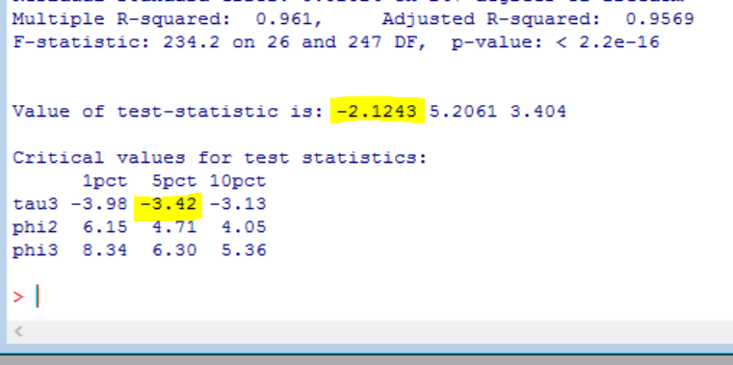
Unit Root:
Unit root test
Using 24 lags – twice the seasonal lags
Test statistic is greater than critical value
Fail to reject the Null
Difference the data.

Slide 8
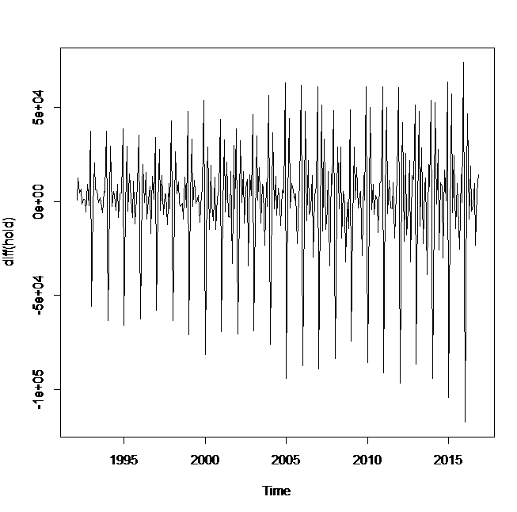
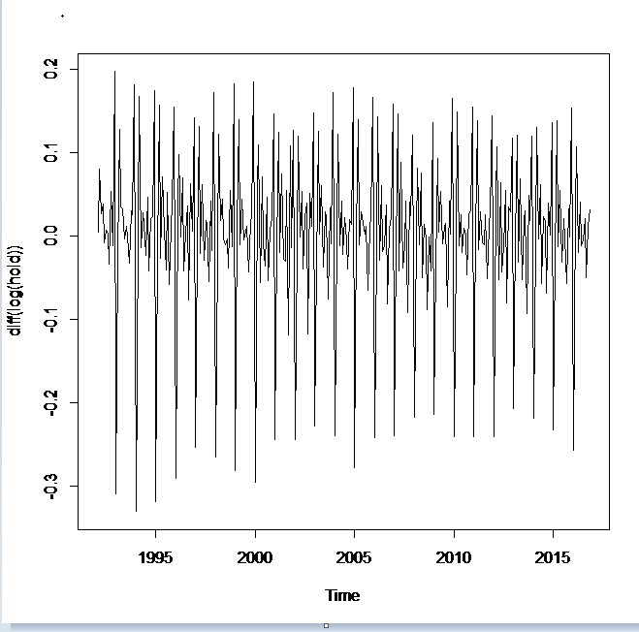
Plots

Slide 9
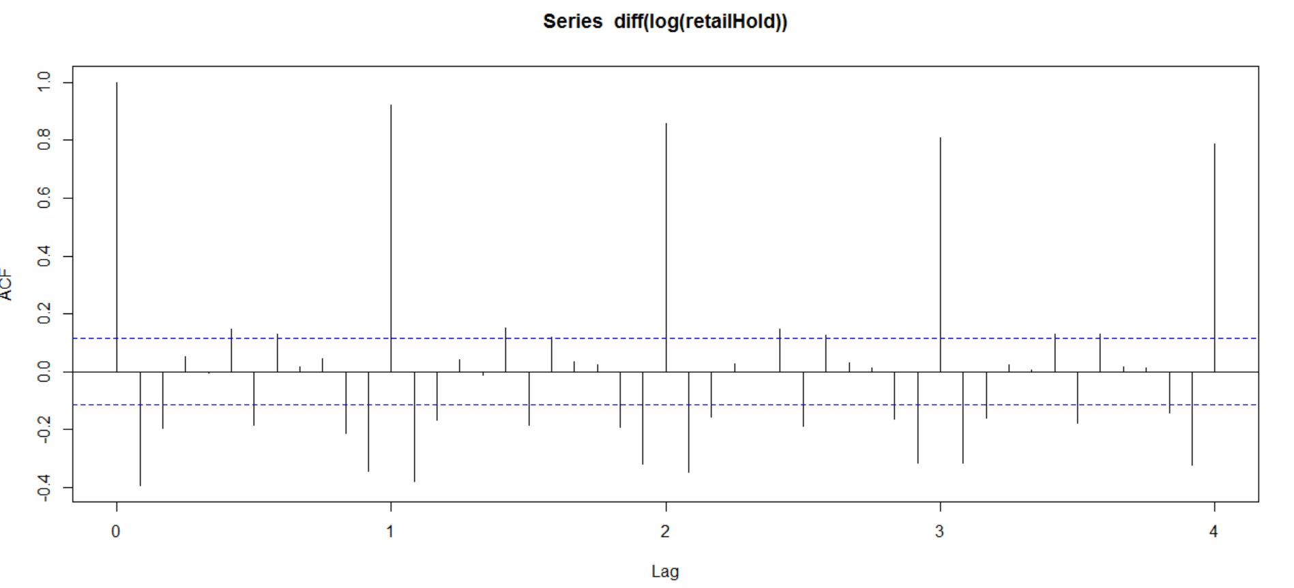
Correlogram plots
Autocorrelation function(ACF):
There is a gradual decay of the ACF which shows the presence of a unit root.
It also suggests that the data is non- stationary.

Slide 10
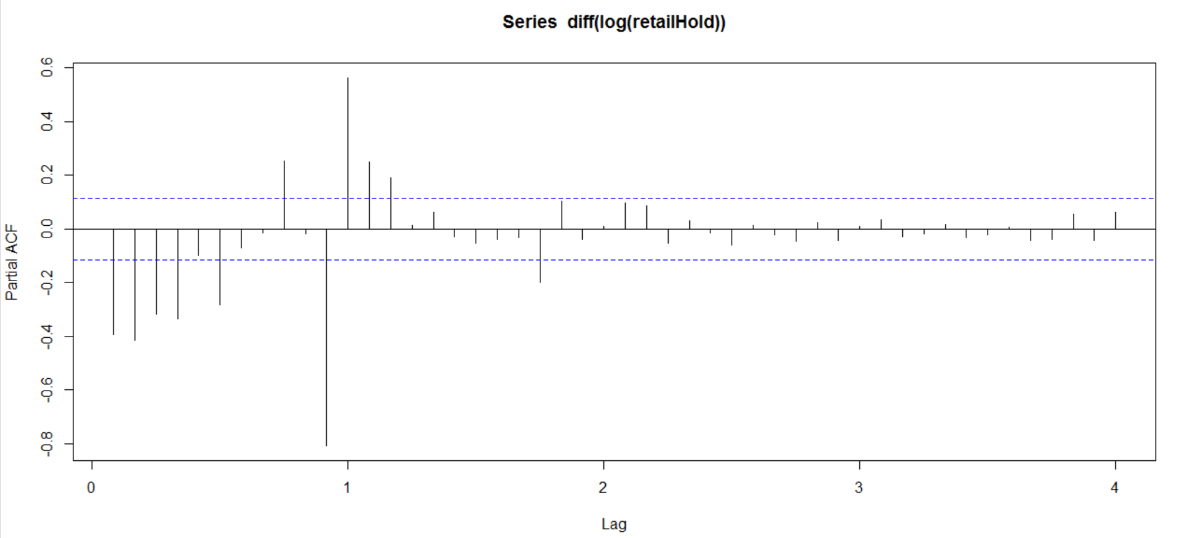
Correlogram plots
Partial Autocorrelation function(PACF):

Slide 11
Model selection
Models | BIC
SARMA(0,1,0)(1,1,0) | -1279.1
SARMA(1,1,0)(1,1,0) | -1334.1
SARMA(1,1,1)(1,1,0) | -1348.8
SARMA(2,1,1)(1,1,0) | -1372.6
SARMA(2,1,2)(1,1,0) | -1370.8
SARMA(2,1,2)(1,1,1) | -1432.3
SARMA(2,1,2)(2,1,1) | -1424.1
SARMA(2,1,2)(2,0,1) | -1440
SARMA(2,1,2)(3,0,1) | -1441.2
SARMA(3,1,2)(2,0,1) | -1480.7
SARMA(2,2,2)(3,0,1) | -1433.9
SARMA(3,1,3)(2,0,1) | -1476.5
SARMA(3,1,2)(2,1,1) | -1461.6

Slide 12
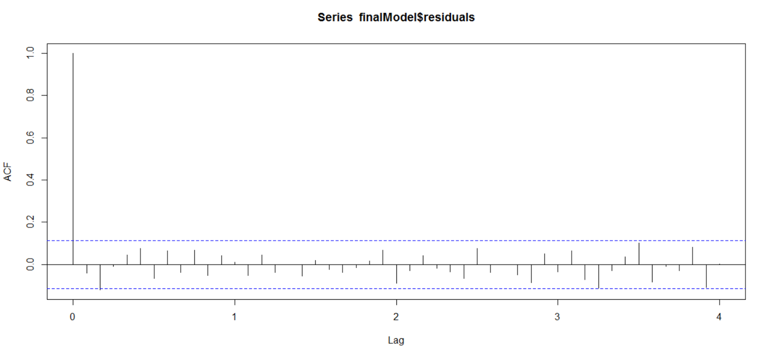
Diagnostic check on Residuals for SARMA(3,1,2)(2,0,1)

Slide 13
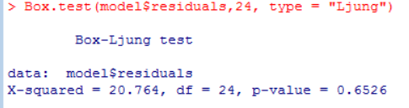
Diagnostic test
Ljung-Box test is conducted for the chosen SARMA(3,1,2)(2,0,1) model.
The test-statistic is less than the critical value
We fail to reject the null hypothesis that all the coefficients are jointly equal to zero.

Slide 14
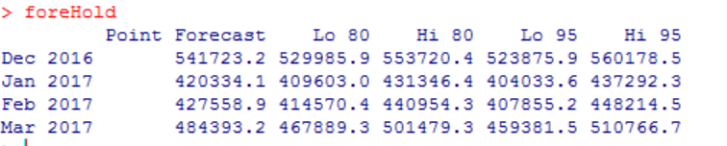
Forecasted Value from Holdout data:
Date | Original value | Forecasted value | Absolute Error
12/1/2016 | 541179 | 541723.2 | 544.2
1/1/2017 | 422799 | 420334.1 | 2464.9
2/1/2017 | 419730 | 427558.9 | 7828.9
3/1/2017 | 482257 | 484393.2 | 2136.2

Slide 15
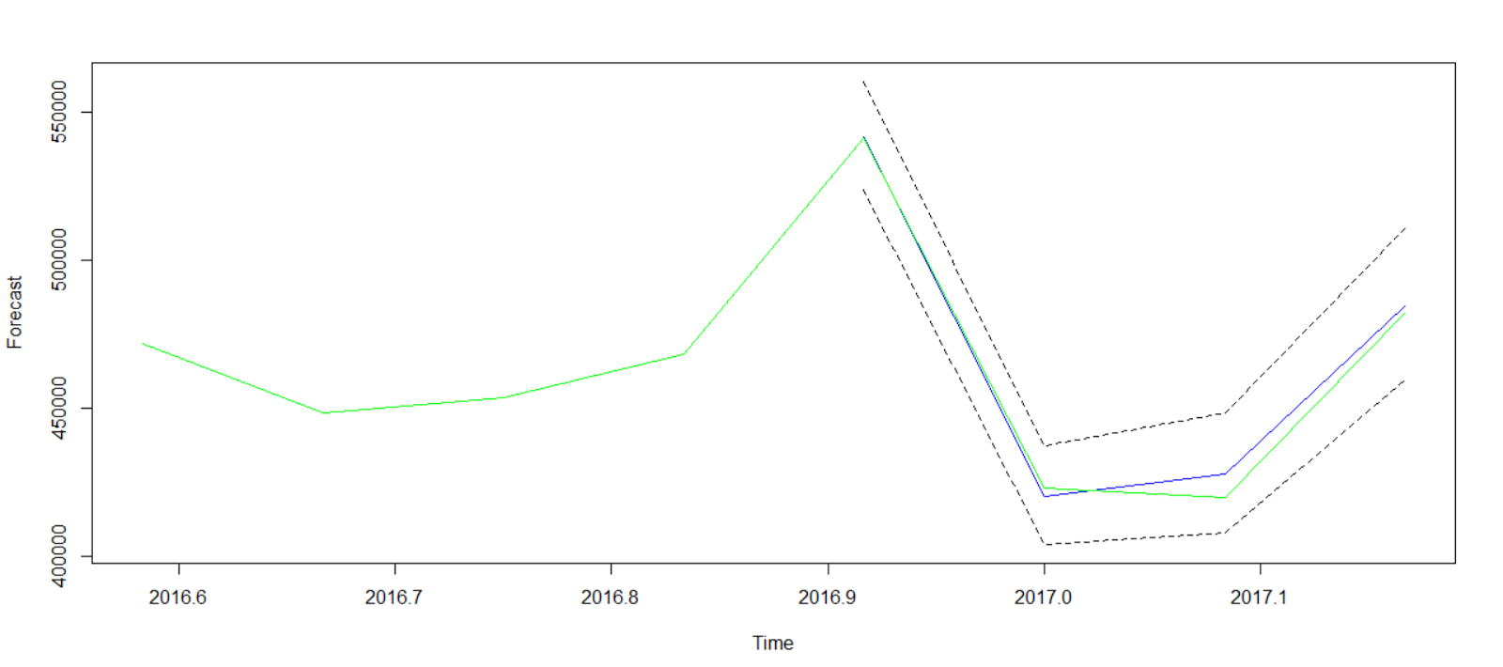
Forecasted Plot (Holdout)

Slide 16
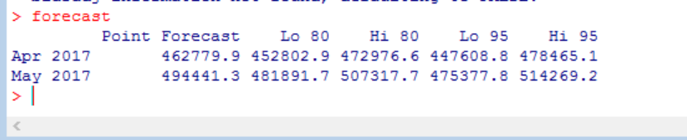
Forecasted values(2 step ahead)

Slide 17
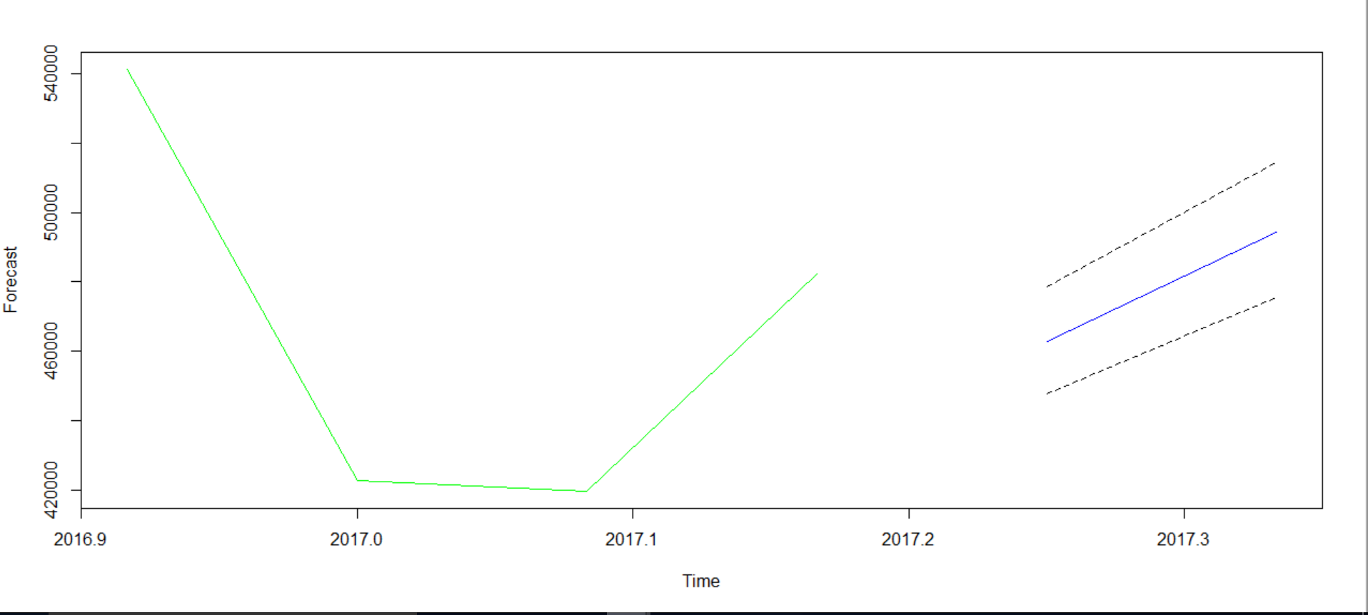
Forecasted Plot(2 step ahead)

